Slide 1
MedFlow AI – An Agentic Cloud-Native Healthcare Intelligence Platform using Microservices, DevOps and DevSecOps
Adaptive Software Engineering – (24CI3201)
TEAM - 3
DOMA AKSHAYA – 2420030474
NALLAPU SREEJA – 2420030267
JITHYA SRI - 2420030586

Slide 2
Problem Statement
Traditional healthcare systems are often monolithic and tightly coupled.
Different healthcare departments may use isolated systems.
Patient, doctor, appointment, laboratory, pharmacy and billing information can become difficult to manage centrally.
Manual workflows can cause:
  Delays
  Data duplication
  Communication gaps
  Limited automation
Traditional systems provide limited intelligent assistance.
Healthcare applications require:
  Security
  Scalability
  Reliability
  Real-time monitoring

Slide 3
Existing System
Existing approach:
Monolithic healthcare applications
Centralized database
Manual workflows
Limited interoperability
Limited AI assistance
Difficult independent scaling
High dependency between modules
Deployment changes can affect the complete application
Limited observability
Security concerns
Problems:
High coupling
Difficult maintenance
Difficult scaling
Single point of failure
Slow feature development
Limited intelligent decision support

Slide 4
Proposed System
MedFlow AI proposes:
Cloud-native microservices architecture
Independent healthcare services
Spring Cloud Gateway
Eureka Service Discovery
JWT authentication
Role-Based Access Control
PostgreSQL database-per-service
AI Service using Spring AI + Gemini
AI Orchestrator
Specialized AI Agents
Controlled AI tool calling
Docker containerization
Kubernetes orchestration
AWS cloud deployment
GitHub Actions CI/CD
DevSecOps security scanning
Prometheus + Grafana monitoring
Microservices:
Patient Service
Doctor Service
Appointment Service
Medical Records Service
Laboratory Service
Pharmacy Service
Nutrition Service
Billing Service
Emergency Service
Notification Service

Slide 5
Objectives
Develop a scalable healthcare management platform
Implement microservices architecture
Provide secure JWT authentication
Implement role-based access control
Enable independent service deployment
Maintain separate databases for services
Integrate AI using Spring AI and Gemini
Develop specialized AI agents
Provide controlled AI tool access
Implement automated CI/CD
Integrate DevSecOps practices
Provide health monitoring and observability
Support Docker and Kubernetes deployment

Slide 6
Stakeholders
Healthcare stakeholders:
Patients
Profile
Appointments
Medical records
Nutrition
Notifications
Doctors
Patient information
Appointments
Medical records
Doctor profile
Receptionists
Registration
Appointment management
Patient coordination
Administrators
User/service management
System administration
Monitoring
Nurses
Patient care workflows
Operational information
Laboratory Staff
Test requests
Reports
Results
Pharmacists
Prescriptions
Medicines
Stock
Emergency Staff
Emergency requests
Prioritization
Billing Staff
Bills
Payments
Transactions

Slide 7
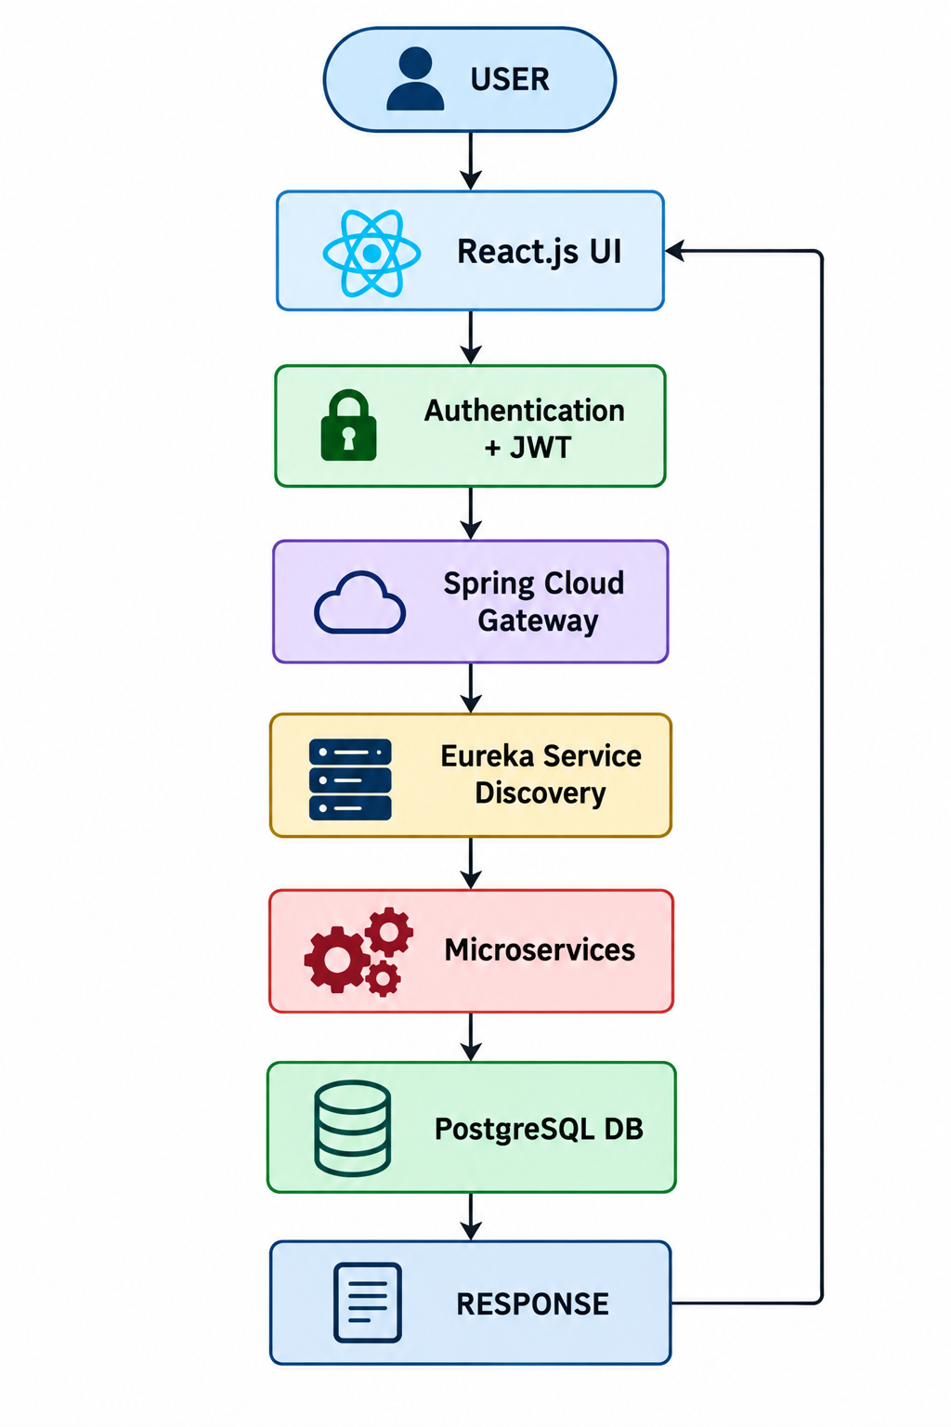
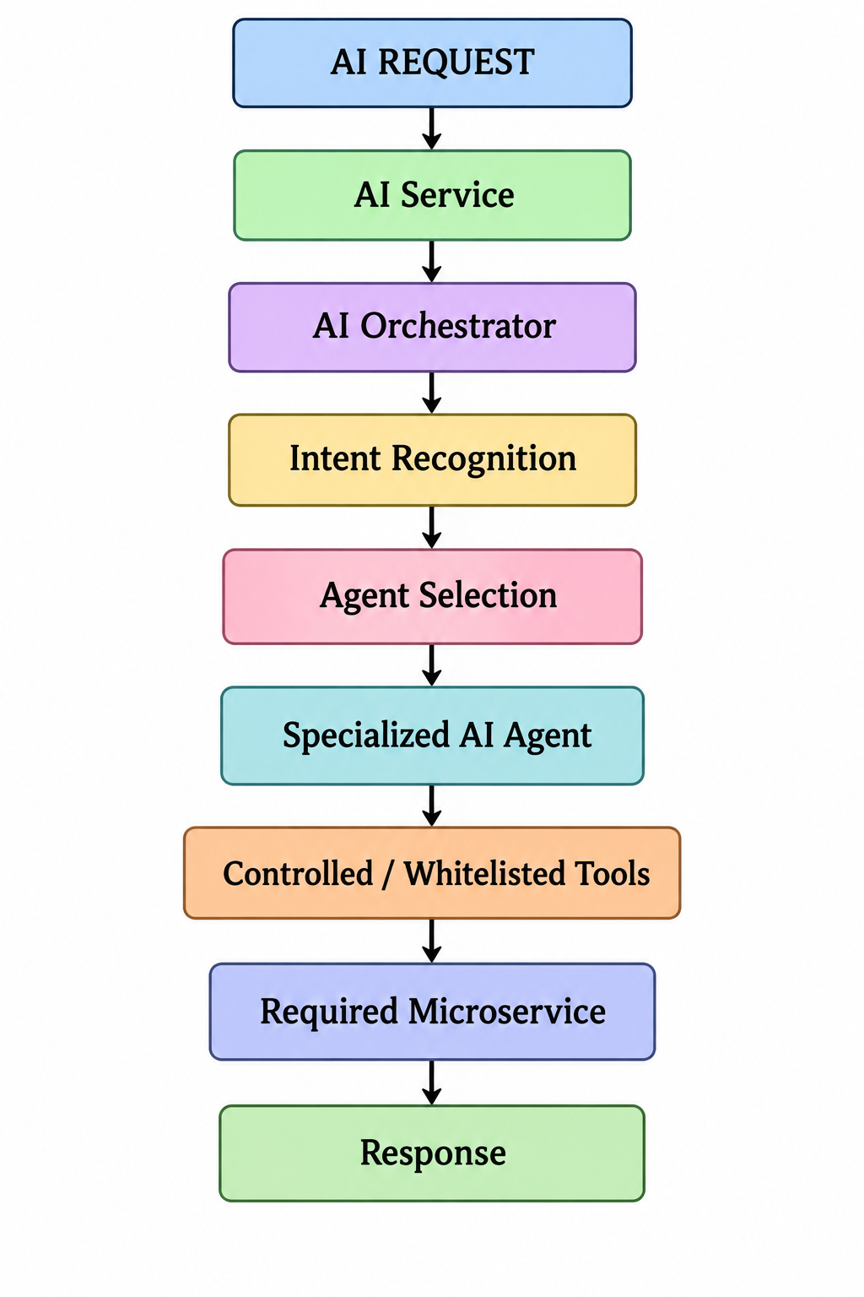
System Workflow

Slide 8
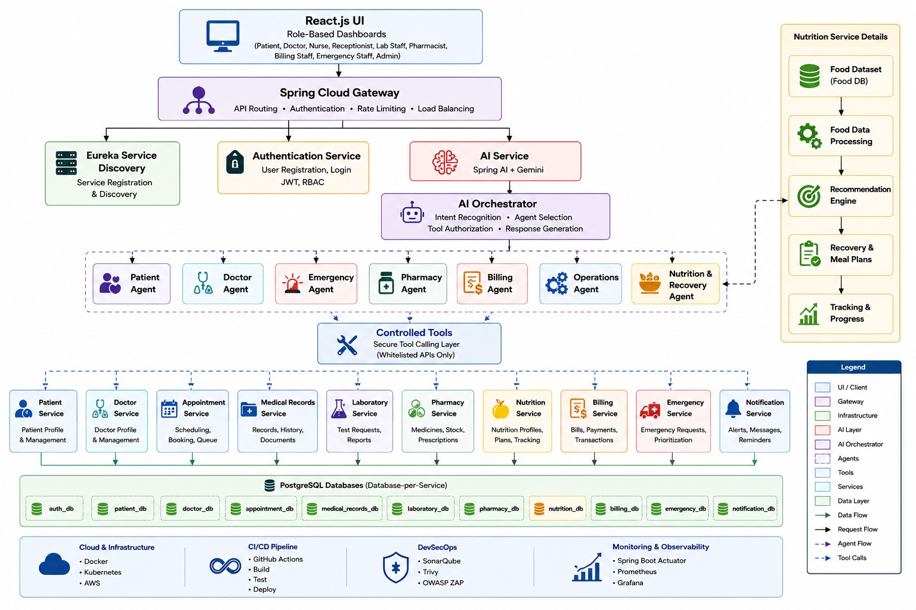
System Architecture

Slide 9
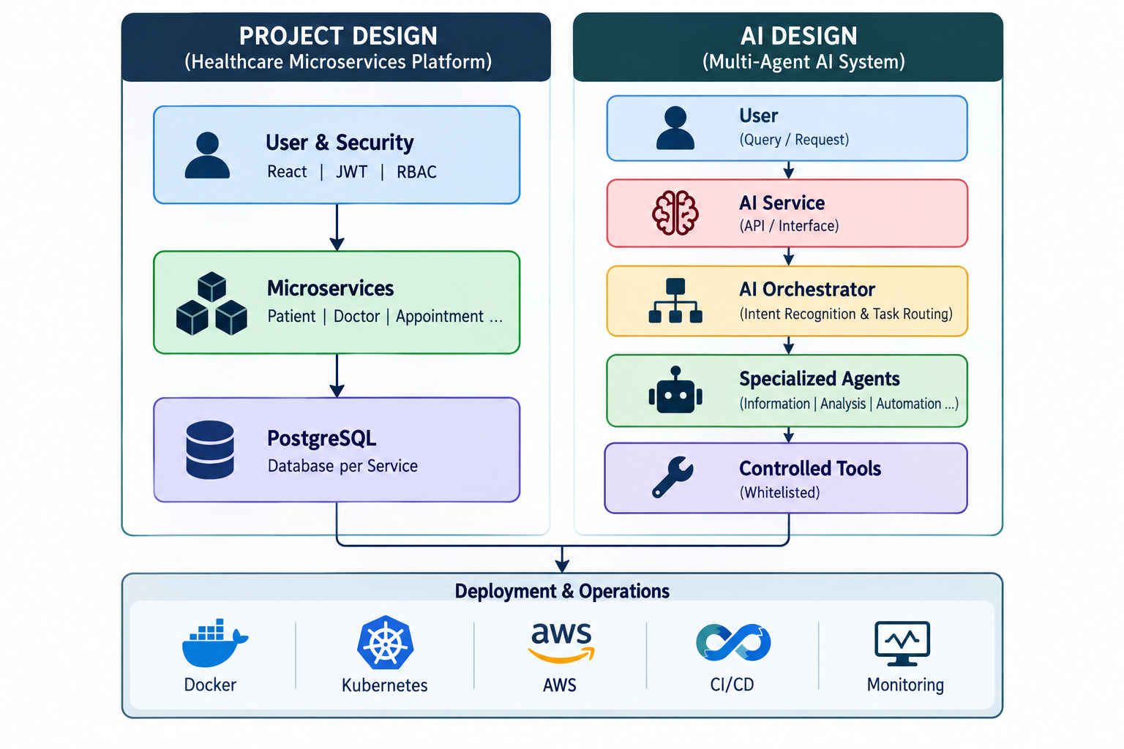
Project Design
1. User & Security Layer
React.js role-based UI
JWT Authentication
Role-Based Access Control
2. Service Layer
Spring Boot Microservices
Patient
Doctor
Appointment
Medical Records
Laboratory
Pharmacy
Nutrition
Billing
Emergency
Notification
3. AI Layer
Spring AI + Gemini
AI Orchestrator
Specialized AI Agents
Controlled Tool Calling
4. Data Layer
PostgreSQL
Database-per-Service
Independent service data
5. Deployment & Operations
Docker
Kubernetes
AWS
CI/CD
Monitoring & Observability

Slide 10
Technology Stack
Category | Technology
Frontend | React.js
Backend | Java
Framework | Spring Boot
Microservices | Spring Boot
Gateway | Spring Cloud Gateway
Discovery | Eureka
Security | Spring Security
Authentication | JWT
AI | Spring AI
AI Model | Gemini
Database | PostgreSQL
Containerization | Docker
Orchestration | Kubernetes
Cloud | AWS
CI/CD | GitHub Actions
Code Quality | SonarQube
Vulnerability Scan | Trivy
Security Testing | OWASP ZAP
Monitoring | Actuator
Metrics | Prometheus
Dashboard | Grafana

Slide 11
AI-Based Features
AI Service
Spring AI
Gemini integration
AI request processing
AI Orchestrator
Intent recognition
Agent selection
Tool authorization
Response generation
Specialized Agents
Patient Agent
Doctor Agent
Emergency Agent
Pharmacy Agent
Billing Agent
Operations Agent
Nutrition & Recovery Agent
Controlled Tools
Whitelisted APIs
Secure tool calling
Restricted backend access
Nutrition AI
Food Dataset
Food Data Processing
Recommendation Engine
Recovery & Meal Plans
Tracking & Progress

Slide 12
System Requirements & Modules
Software Requirements
Windows/Linux/macOS
Java
Maven
Node.js
React.js
PostgreSQL
Git
Docker
Kubernetes
kubectl
IDE such as VS Code/IntelliJ/STS
Functional Modules
Authentication
Patient Management
Doctor Management
Appointment Management
Medical Records
Laboratory
Pharmacy
Nutrition
Billing
Emergency
Notifications
AI Assistance
Administration

Slide 13
Testing, Outcomes & Future Scope
Testing
Unit testing
API testing
Integration testing
Authentication testing
Authorization testing
Microservice communication testing
Database testing
AI workflow testing
Security testing
Health-check testing
Expected/Implemented Outcomes
Independent microservices
Secure authentication
Role-based access
Independent databases
AI-assisted workflows
Controlled AI tool access
Containerized deployment
Automated CI/CD
Monitoring and observability
Future Scope
More specialized AI agents
Advanced predictive analytics
Voice-based healthcare assistant
Mobile application
Advanced hospital integrations
Real-time analytics
More cloud automation
Advanced AI evaluation
Enhanced Kubernetes scaling

Slide 14
Conclusion & Future Scope
Conclusion
MedFlow AI combines:
  Healthcare management
  Microservices
  Artificial Intelligence
  DevOps
  DevSecOps
  Cloud technologies
Provides modular and scalable architecture
Provides secure role-based access
Uses database-per-service
Provides intelligent assistance through specialized agents
Uses controlled AI tool calling
Supports containerized cloud deployment
Provides monitoring and observability
Future Scope
Advanced AI agents
Predictive healthcare analytics
Mobile application
Voice assistant
Wearable/IoT integration
Advanced personalization
Multi-hospital integration
Cloud auto-scaling

Slide 15
THANK YOU

